Slide 1


Big DATA & HADOOP | MACHINE LEARNING
UNIT 3| BIG DATA ANALYTICS

Slide 2
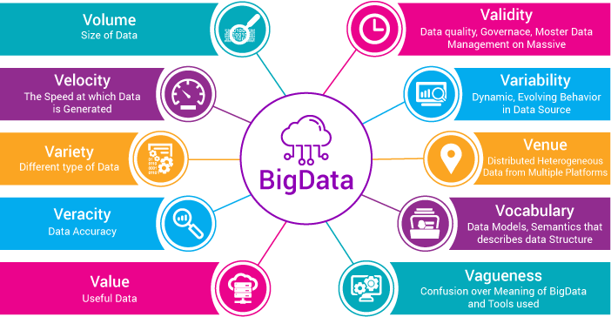
BIG DATA | AT A GLANCE

Slide 3

What is Hadoop
Apache Hadoop is an open source software framework used to develop data processing applications which are executed in a distributed computing environment.
Applications built using HADOOP are run on large data sets distributed across clusters of commodity computers.
Commodity computers are cheap and widely available. These are mainly useful for achieving greater computational power at low cost.

Slide 4
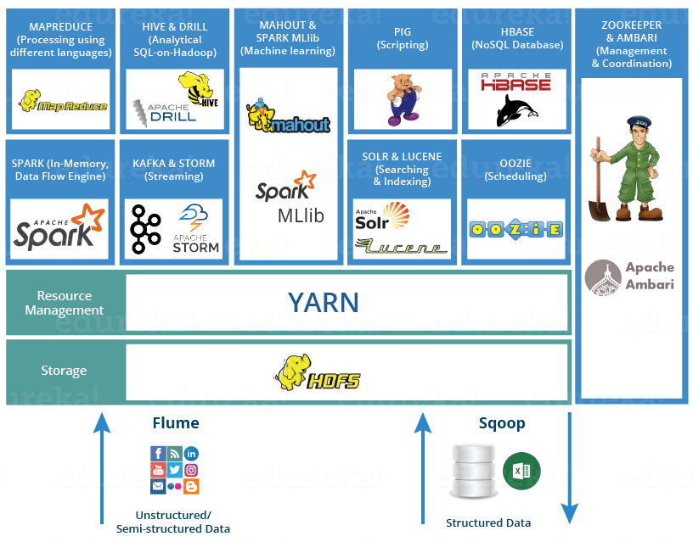
Hadoop ECOSYSTEM

Slide 5
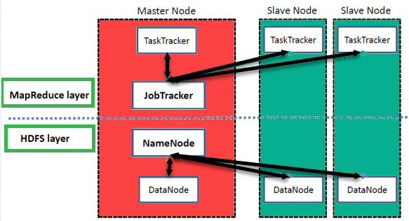
HADOOP ARCHITECTURE
Hadoop MapReduce: MapReduce is a computational model and software framework for writing applications which are run on Hadoop.
HDFS (Hadoop Distributed File System): HDFS takes care of the storage part of Hadoop applications. MapReduce applications consume data from HDFS.
HDFS creates multiple replicas of data blocks and distributes them on compute nodes in a cluster. This distribution enables reliable and extremely rapid computations.
HADOOP ARCHITECTURE

Slide 6

HDFS Architecture

Slide 7
HDFS Architecture
A file on HDFS is split into multiple bocks and each is replicated within the Hadoop cluster.
A block on HDFS is a blob of data within the underlying file system with a default size of 64MB.The size of a block can be extended up to 256 MB based on the requirements.
Hadoop Distributed File System (HDFS) stores the application data and file system metadata separately on dedicated servers.
NameNode and DataNode are the two critical components of the Hadoop HDFS architecture.
Application data is stored on servers referred to as DataNodes and file system metadata is stored on servers referred to as NameNode. HDFS replicates the file content on multiple DataNodes based on the replication factor to ensure reliability of data.
Java is the native language of HDFS. Hence one can deploy DataNode and NameNode on machines having Java installed.

Slide 8
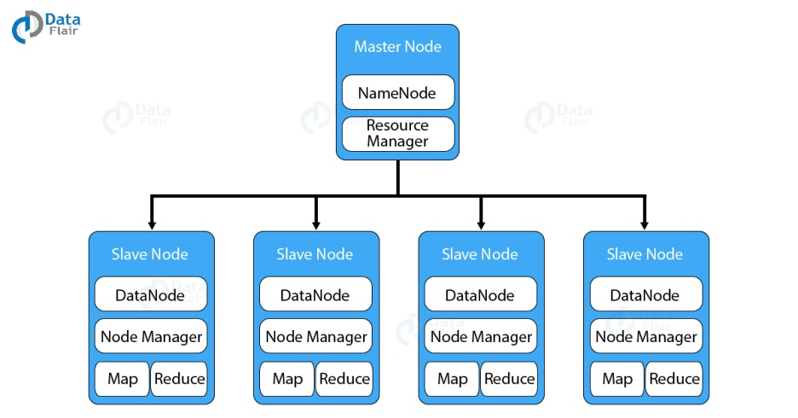
HDFS | Name& Data NODE
HDFS has a Master-slave architecture.
The daemon called NameNode runs on the master server. It is responsible for Namespace management and regulates file access by the client.
DataNode daemon runs on slave nodes. It is responsible for storing actual business data

Slide 9
HDFS | Name& Data NODE
Internally, a file gets split into a number of data blocks and stored on a group of slave machines.
Namenode manages modifications to file system namespace. These are actions like the opening, closing and renaming files or directories.
NameNode also keeps track of mapping of blocks to DataNodes.
This DataNodes serves read/write request from the file system’s client.
DataNode also creates, deletes and replicates blocks on demand from NameNode.

Slide 10
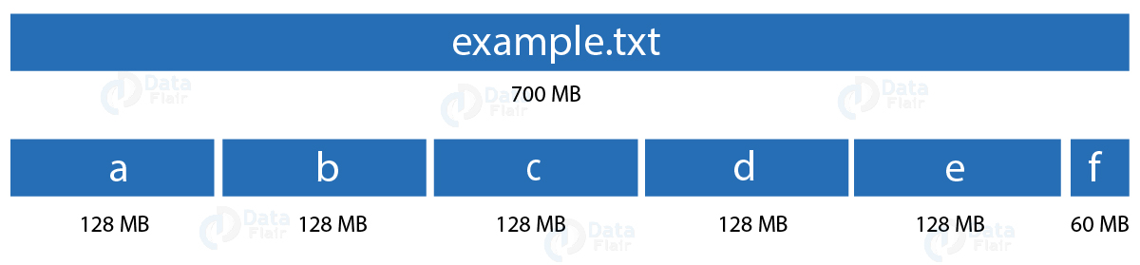
HDFS | Blocks
Block is nothing but the smallest unit of storage on a computer system. It is the smallest contiguous storage allocated to a file.
In Hadoop, we have a default block size of 128MB or 256 MB.
What will happen if the block is of size 4KB? But in HDFS we would be having files of size in the order terabytes to petabytes. With 4KB of the block size, we would be having numerous blocks. This, in turn, will create huge metadata which will overload the NameNode. Hence we have to choose our HDFS block size judiciously.

Slide 11
HDFS | Blocks
Block is nothing but the smallest unit of storage on a computer system. It is the smallest contiguous storage allocated to a file.
In Hadoop, we have a default block size of 128MB or 256 MB.
What will happen if the block is of size 4KB? But in HDFS we would be having files of size in the order terabytes to petabytes. With 4KB of the block size, we would be having numerous blocks. This, in turn, will create huge metadata which will overload the NameNode. Hence we have to choose our HDFS block size judiciously.

Slide 12
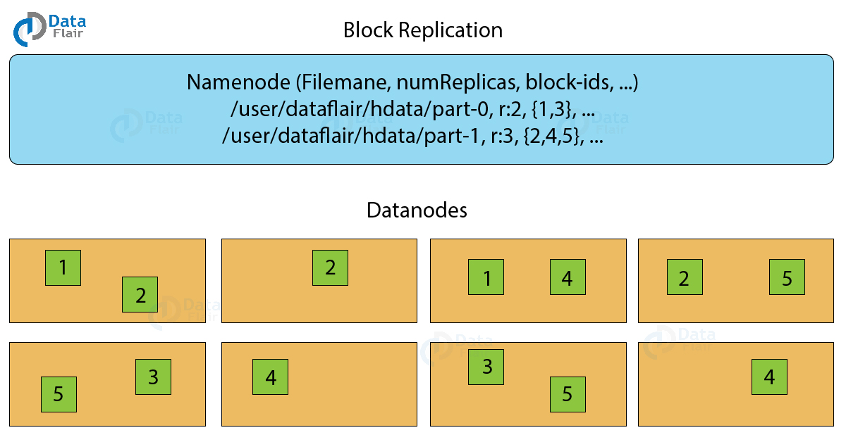
HDFS | Block Replication
To provide fault tolerance HDFS uses a replication technique. In that, it makes copies of the blocks and stores in on different DataNodes. Replication factor decides how many copies of the blocks get stored. It is 3 by default but we can configure to any value.

Slide 13

Map Reduce
MapReduce is the data processing layer of Hadoop.
It is a software framework that allows you to write applications for processing a large amount of data.
MapReduce job comprises a number of map tasks and reduces tasks.
Each task works on a part of data. This distributes the load across the cluster.
The function of Map tasks is to load, parse, transform and filter data. Each reduce task works on the sub-set of output from the map tasks.
Reduce task applies grouping and aggregation to this intermediate data from the map tasks.

Slide 14
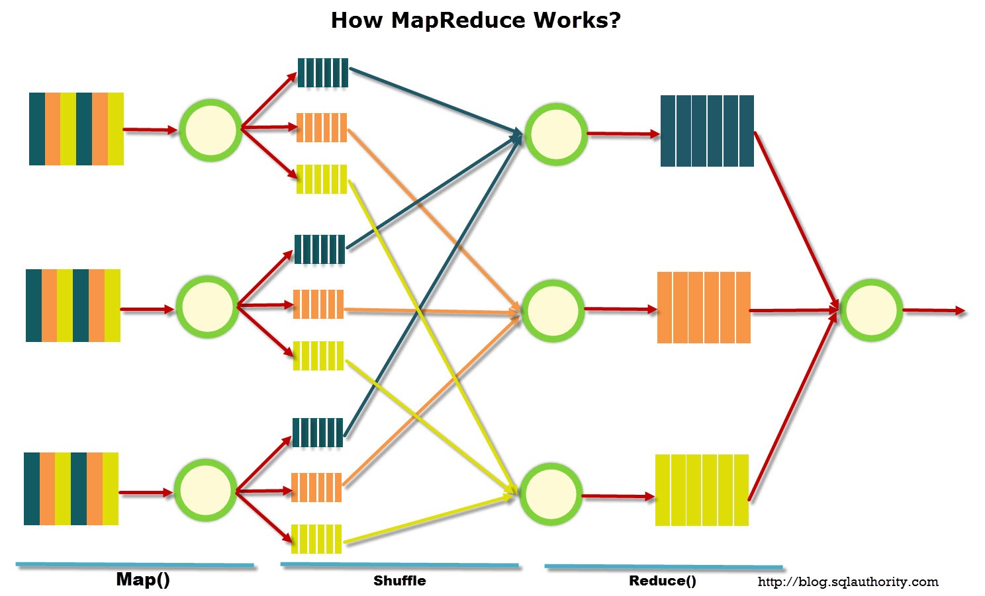
Map Reduce

Slide 15
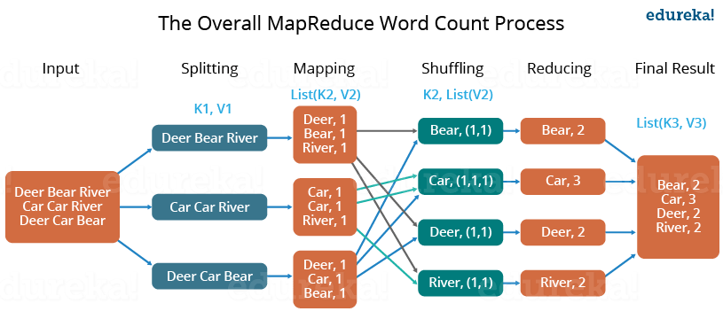
Map Reduce

Slide 16
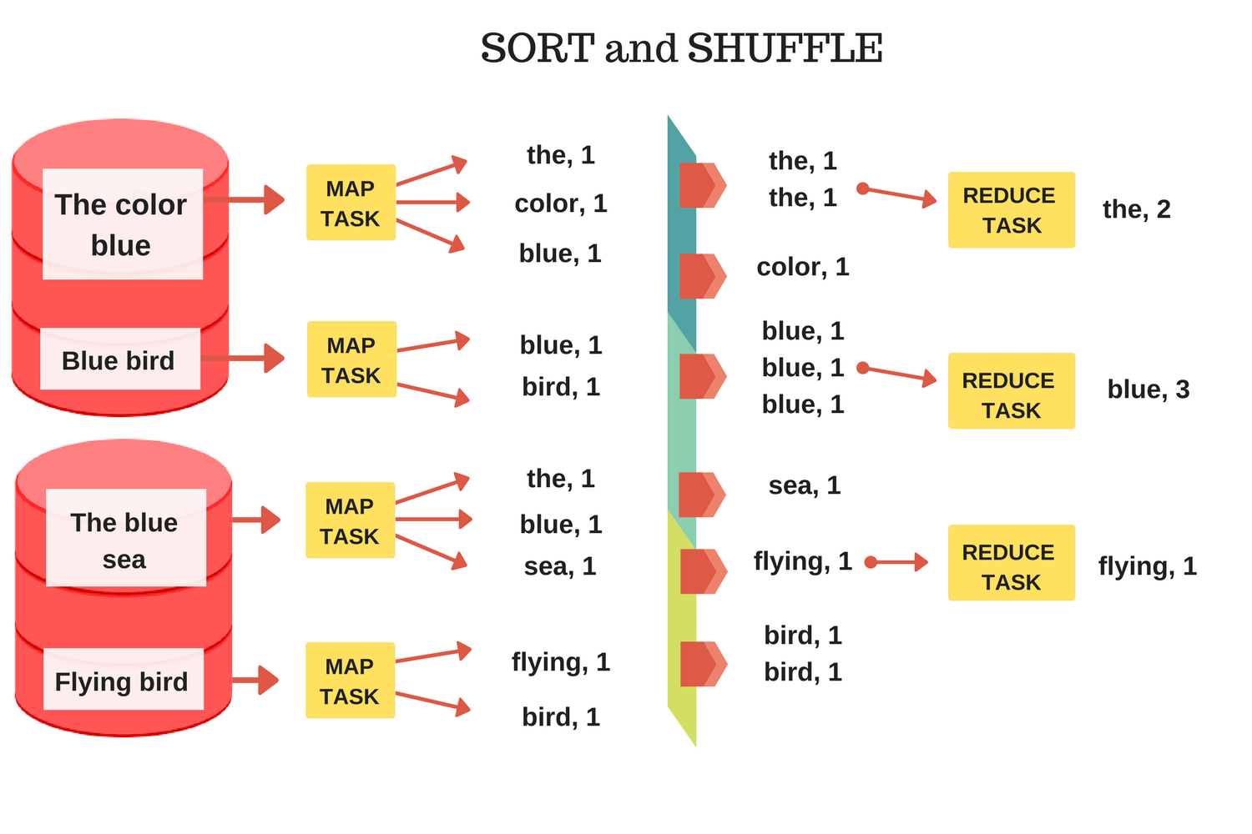
Map Reduce

Slide 17
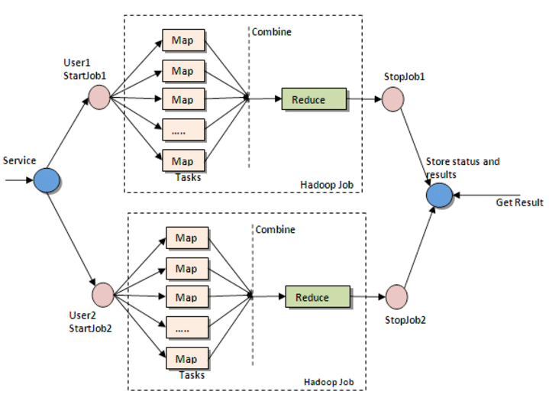
Map Reduce

Slide 18
Map Reduce
The input file for the MapReduce job exists on HDFS.
The input format decides how to split the input file into input splits.
Input split is nothing but a byte-oriented view of the chunk of the input file.
This input split gets loaded by the map task. The map task runs on the node where the relevant data is present.
The data need not move over the network and get processed locally.

Slide 19
Map Reduce| Map Function
Record Reader
The recordreader transforms the input split into records. It parses the data into records but does not parse records itself.
Map
Mapper processes the key-value pair from the recordreader. It produces zero or multiple intermediate key-value pairs.
Combiner
The combiner is a localised reducer which groups the data in the map phase.
The decision of what will be the key-value pair lies on the mapper function.
Partitioner
Partitioner pulls the intermediate data from the mapper.
It provides the data to the mapper function in key-value pairs. Usually, the key is the positional information and value is the data that comprises the record.
The key is usually the data on which the reducer function does the grouping operation. And value is the data which gets aggregated to get the final result in the reducer function.
It is optional.
Combiner takes the intermediate data from the mapper and aggregates them. It does so within the small scope of one mapper.
It splits them into shards, one shard per reducer.

Slide 20
Map Reduce| Reduce
Shuffle step downloads the data written by practitioner to the machine where reducer is running.
This step sorts the individual data pieces into a large data list(the equivalent keys ).
The framework does this so that we could iterate over it easily in the reduce task.
This performs the reducer function once per key grouping. The framework passes the function key and an iterator object containing all the values pertaining to the key.
We can write reducer to filter, aggregate and combine data in a number of different ways.
This is the final step. It takes the key-value pair from the reducer and writes it to the file by recordwriter.
By default, it separates the key and value by a tab and each record by a newline character.
Shuffle
&
Sort
Reduce
Output Format

Slide 21

Machine Learning

Slide 22
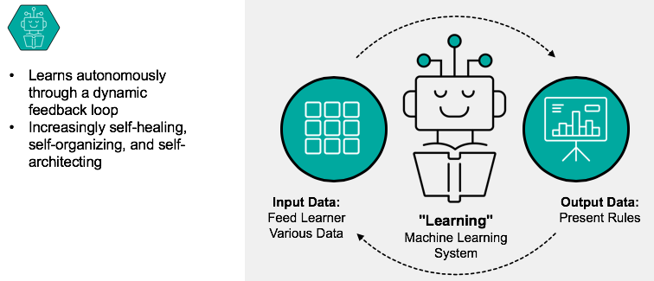
Machine Learning

Slide 23

What is Machine Learning

Slide 24
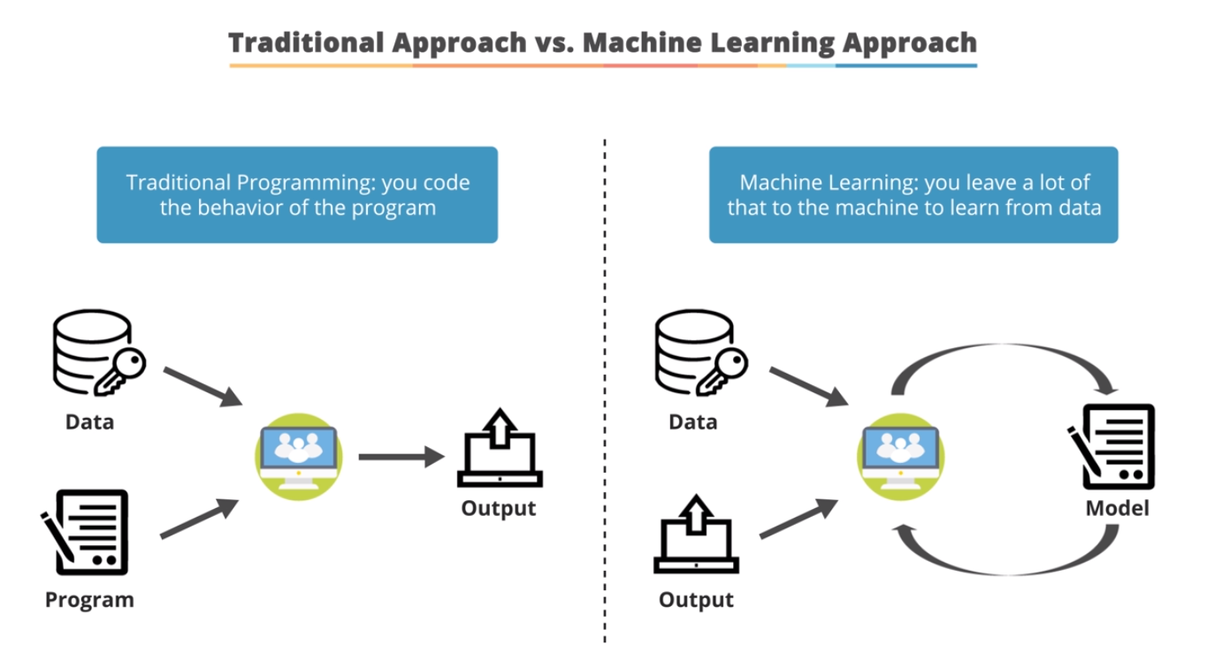
ML Vs Traditional Programming

Slide 25
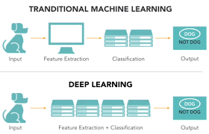
ML & Deep Learning

Slide 26

AI & ML

Slide 27

Machine Learning Types

Slide 28
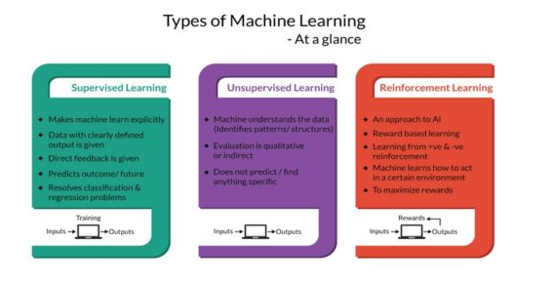
Machine Learning Types

Slide 29
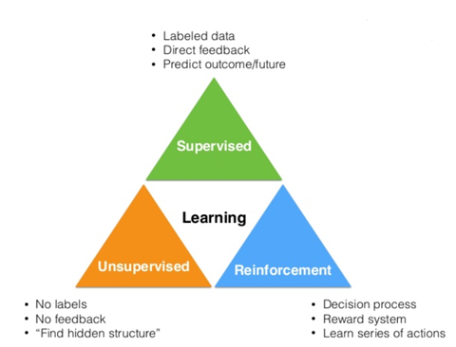
Machine Learning Types

Slide 30
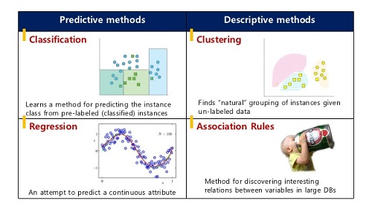
Data Mining Methods

Slide 31
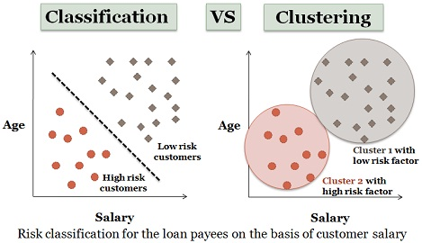
Data Mining Methods

Slide 32
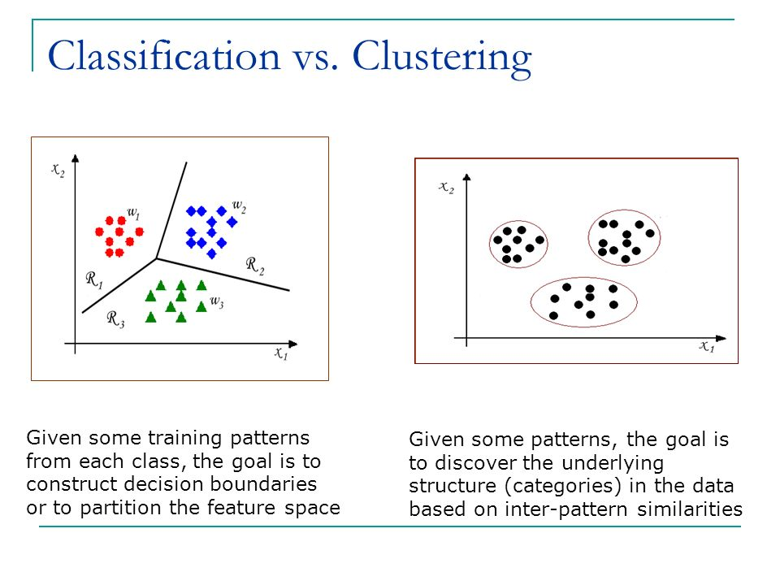
Data Mining Methods

Slide 33


